Slide 1
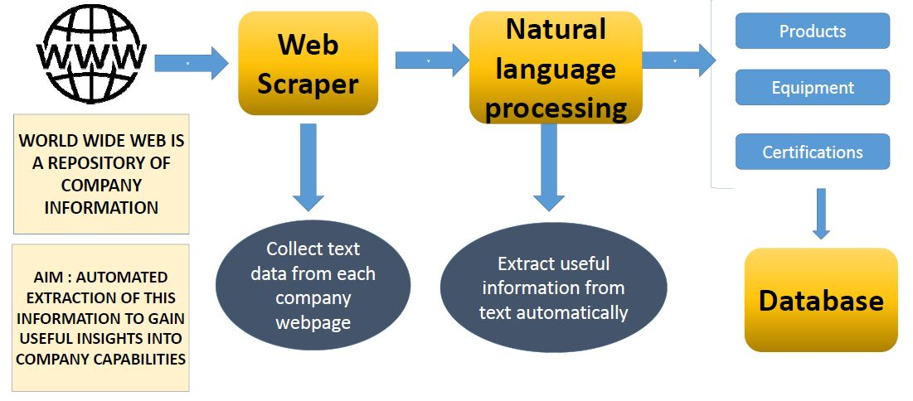
Supply Chain Leakage reduction project
Project Advisors: Prof. Ananth Iyer, Prof Steve Dunlop, Prof Mohammad Rahman
Student Team : Mihir Bhatia, Deepika Jindal, Anesh Krishna , Nachiket Joshi, Hemanth Devavarapu
GOAL of Supply Chain leakage project
Identify capabilities of manufacturing companies in the WHIN region
Take stock of aggregate capabilities in the 10 counties comprising the WHIN region
Use the data to gain macro insights
Explore subsets of companies with required set of capabilities for new industry
Find ways to assist LEDOs, procurement managers and companies to work to reduce supply chain leakage
What is the problem ?
Example: Oerlikon Fairfield
URL https://www.oerlikon.com/fairfield/eng
Large numbers of web-links (441 weblinks)
Many pages of raw data (602 pages)
Several individual searches to get an answer
Context dependent interpretation
Long run time (over 3 hours for one company)
We need a better way to do this…
Completed analysis of 226 companies (Union of 236+270 gave 397 companies, so we have 171 more to go)
Extracted data from the company websites
Focused on a few attributes for now
Company type (Manufacturing, Distributor etc)
Equipment
Certifications
Products

Slide 2
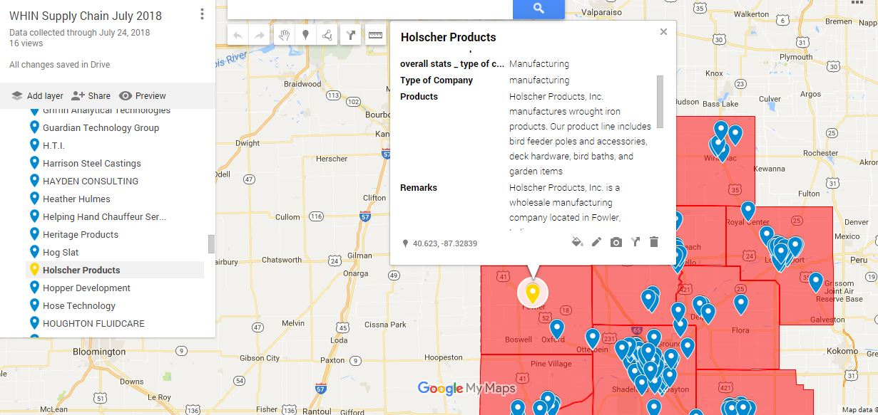
Supply Chain Leakage reduction project
Project Advisors: Prof. Ananth Iyer, Prof Steve Dunlop, Prof Mohammad Rahman
Student Team : Mihir Bhatia, Deepika Jindal, Anesh Krishna , Nachiket Joshi, Hemant Devavarapu
County | Count of Companies with equipment data available
Benton | 1
Cass | 11
Clinton | 1
Fountain | 1
Montgomery | 2
Tippecanoe | 10
Warren | 5
White | 3
Grand Total | 34
Equipment categories | Number of companies
CNC | 18
Press | 13
Weld | 11
Computer | 4
Laser | 7
Hydraulic | 2
Stamp | 1
Cutting | 8
County/ Company Type | Manufacturing | Chemical | Maintenance | Software | Suppliers | Logistics | Insurance | Distributor | Security | Packaging | Janitorial | Grand Total
Benton | 3 |  | 1 |  |  |  |  | 1 |  |  |  | 5
Carroll | 3 |  |  |  | 1 |  |  |  |  |  |  | 4
Cass | 15 |  | 3 |  | 2 |  |  | 1 |  |  | 1 | 22
Clinton | 7 | 1 |  |  | 1 | 1 |  |  | 1 |  |  | 11
Fountain | 4 | 1 |  |  |  |  |  |  |  |  |  | 5
Montgomery | 7 | 1 |  | 2 | 1 | 3 |  | 1 |  | 3 |  | 18
Pulaski | 3 |  |  |  |  |  |  | 1 |  |  |  | 4
Tippecanoe | 30 | 7 | 2 | 5 | 1 |  | 6 | 2 | 4 |  | 1 | 58
Warren | 7 |  |  |  |  |  |  |  |  |  |  | 7
White | 6 |  | 2 | 1 |  | 1 |  |  |  | 1 |  | 11
Grand Total | 85 | 10 | 8 | 8 | 6 | 5 | 6 | 6 | 5 | 4 | 2 | 145

